Slide 1

Faculty Evaluation and Performance Counseling
Gwendolyn Singleton, Ph.D.
Florida A&M University
INSTITUTE FOR ACADEMIC LEADERSHIP
October 2, 2017

Slide 2



Evaluation?
Performance Counseling?
Notes:
What do we/faculty typically think about Evaluation and Performance Counseling? Microscope, put down, demands blasted at you… If conducted appropriately can be very Empowering!

Slide 3

Faculty Evaluations
Assessment of Faculty Performance
Teaching
Research and Other Creative Activities
Service
Other University Duties

Slide 4

Purpose of Faculty Evaluations
To help faculty to improve their performance
To improve the institution
Used to make personnel decisions
  Retention/Reappointment
  Promotion
  Tenure
  Salary Increases/Merit pay

Slide 5
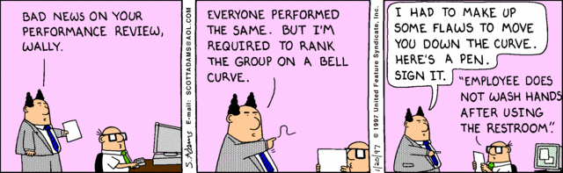
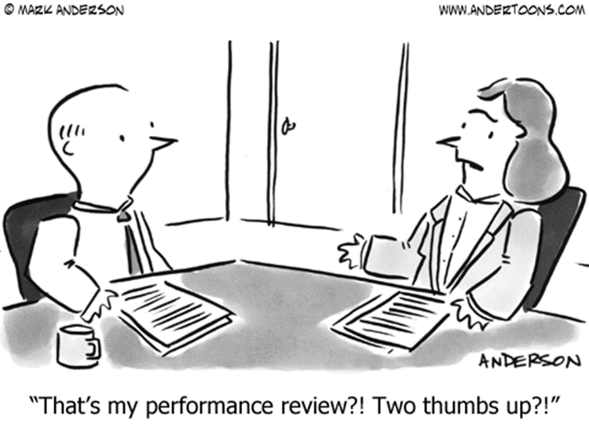
Faculty Responses
Concerns
  Negative evaluation
  Unclear criteria
  Unfair assessment
  Misuse of information
  Negative outcomes

Slide 6


Faculty Responses
Responses
  Fear
  Anxiety/trepidation
  Resistance
  Anger
  Blame
  Complaints (formal and informal)

Slide 7

Chair’s Responsibilities
Faculty Performance Evaluations
  Most difficult
  Important responsibility
Performance Counseling
  Valuable communications tool
  Regular contact between chair and faculty
  Focus: successes, failures, concerns, needs
  Very difficult
Confidentiality
Honest
Document
Notes:
Especially important for Tenure-earning and Faculty members whose performance has been labeled as deficient at time of evaluation.
Be Honest: Look for strong points that can offset weak points OR gloss over problems, especially those considered minor
Another distortion results when justifiable criticisms are turned into compliments.

Slide 8

Chair’s Responsibilities
Handled improperly
  Damage relationship with Faculty members
  Decrease Faculty morale
  Decrease Departmental success in meeting its objectives
  Grievances
Notes:
Avoid lumping all a faculty member’s shortcomings into one bundle and dumping it on the unsuspecting person without warning.

Slide 9

What Can Chairs Do?
Evaluations
Counseling
Notes:
It is difficult to tell someone that his or her performance has been unsatisfactory without provoking a defensive reaction. Defensiveness is natural (for faculty & chair) but counterproductive and should be minimized whenever possible. May be diffused if discussion about performance is viewed as counseling session rather than an interview for formal evaluation.

Slide 10
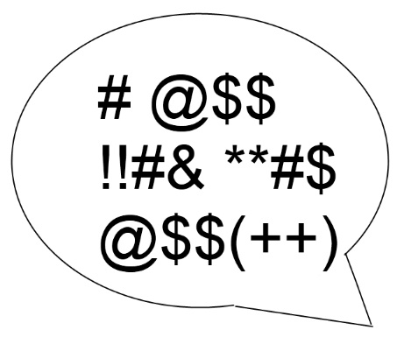
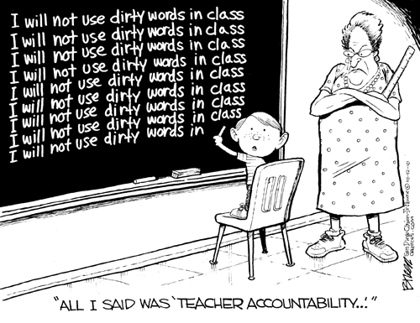
REMOVE NEGATIVE CONNOTATIONS
EVALUATION!
COUNSELING!
Notes:
Work to change the culture relative to Faculty Evaluations. Highlight mutual benefits. Encourage good performance year round NOT once/year.

Slide 11
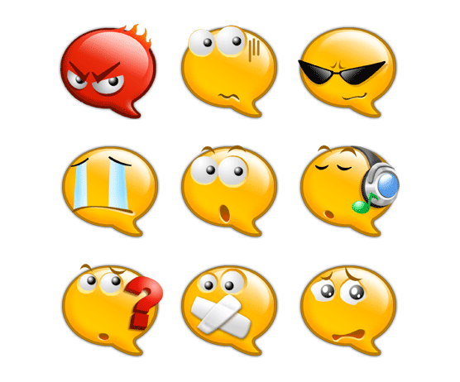
Remove EMOTIONS from the evaluation & counseling process.
EMOTION-FREE ZONE
It isn’t personal.
Notes:
Isn’t personal: Not a reflection of your leadership; & don’t give faculty reasons to feel that it is personal
Chair may perceive unsatisfactory faculty performance as a personal insult or as a poor reflection of his/her leadership abilities.
The faculty member should be made to feel that his/her poor performance need not be shouldered alone, that it is a problem for the whole department and can be solved cooperatively for the good of the department.

Slide 12
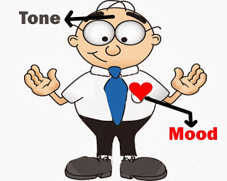
Setting the Tone
Frame the process positively
Understand the process and purpose
Comfort/Acceptance of the idea and process
Productive and supportive leadership
Faculty will likely follow your lead
Notes:
Chairs/Directors set the tone for the evaluation & performance counseling. Reframe as opportunities for improvement.

Slide 13
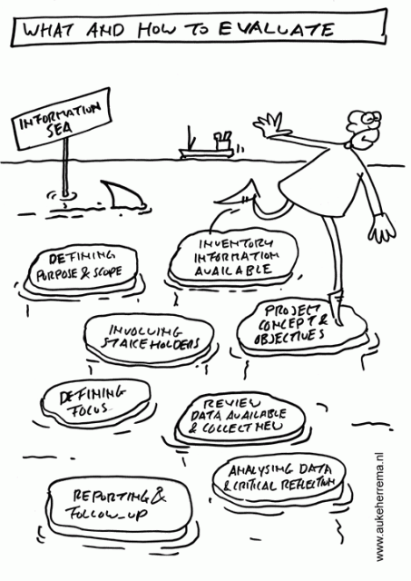
Demystify the Process
CLEAR CRITERIA
BASED ON ASSIGNMENT
PURPOSE
CLEAR COMMUNICATION
DOCUMENT
Notes:
To reduce resistance, fear, apprehension and other negative emotions
Transparent accountability

Slide 14
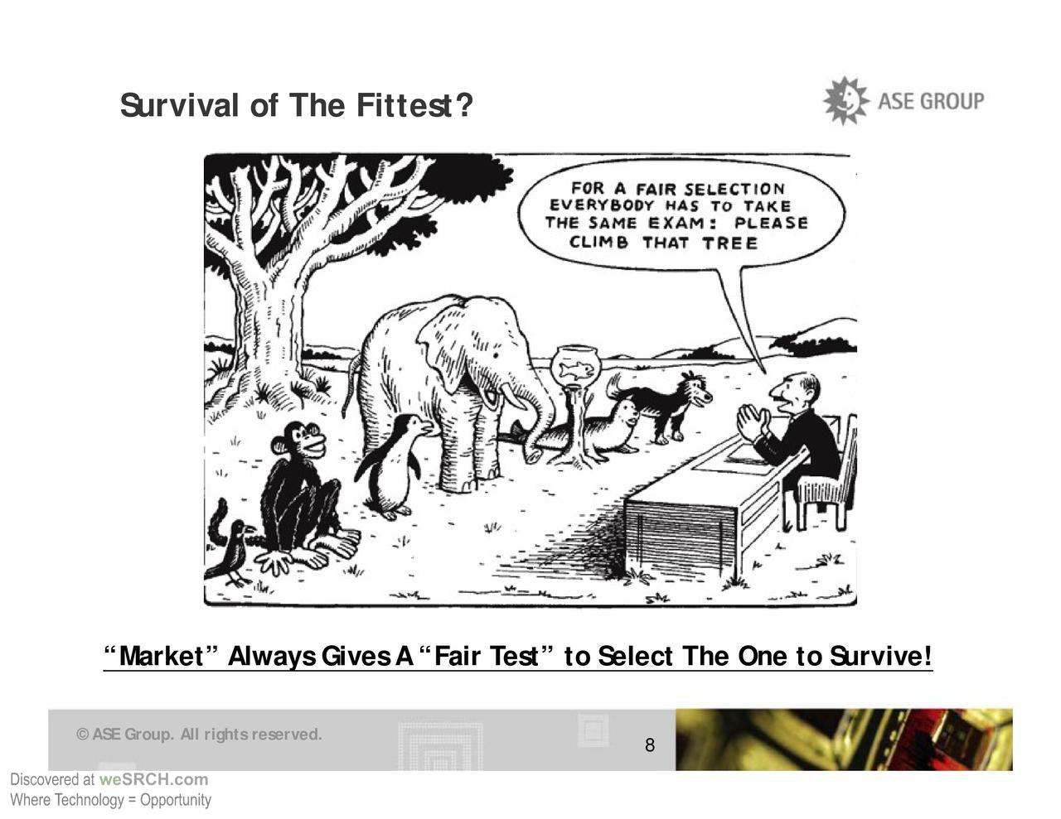
DEFINE CRITERIA
AVOID “ONE SIZE FITS ALL” APPROACH
TENURE-EARNING
Our Education System
“Everybody is a genius. But if you judge a fish by its ability to climb a tree, it will live its whole life believing that it is stupid.”
-Albert Einstein
NEEDS
BASED

Slide 15
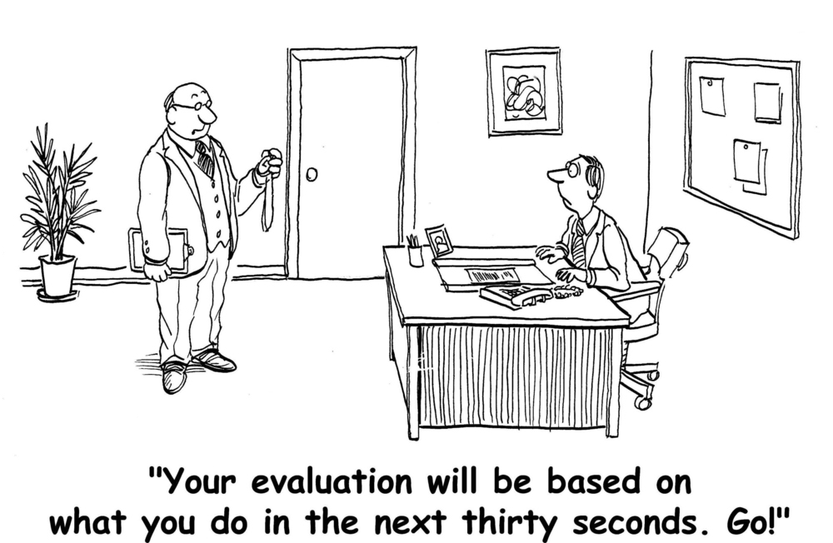
ONGOING PROCESS
Notes:
Provide guidance/encouragement to actively plan and frequently participate in professional development/scholarly activities.

Slide 16

EMPOWER FACULTY
Mentoring for Junior Faculty
Professional Development Opportunities
Recommend Regular Scholarly Activities
Faculty Involvement
  Faculty Department-Aligned Goals (mutual benefits)
  Faculty Self-Evaluations
  Faculty-Created Improvement Plan
Notes:
Make evaluation a collaborative efforts; You will be viewed as an ally rather than the enemy.
Highlight benefits to faculty, department, students, institution.
Active participant in Performance Counseling.

Slide 17

FACULTY EVALUATIONS
PERFORMANCE COUNSELING
?CHAIRS/DIRECTORS?
Notes:
Your approach/responses are important determining factors in faculty viewing you as an ally or an enemy in these processes.

Slide 18
THANK YOU!
Questions?

